Slide 1



The
Badminton Zone
The Code Crafter
The CodeCrafters
Home
Introduction
Content
Reference
Trần Nguyễn Thanh Bình - Project Manager, Backend developer
Võ Quốc Bình - Backend developer
Đinh Thế Anh - Frontend developer
Nguyễn Mậu Gia Bảo - Frontend developer
Bùi Nguyễn Tin - Frontend developer

Slide 2
The CodeCrafters
Home
Introduction
Content
Reference
Introduction
The Badminton Zone is a website that allows users to search for and reserve sports facilities based on their specific needs. Providing contact information so that court owners can communicate directly with clients; providing a platform for court owners to manage the business of sporting facilities.
Functions of website
Log in/ Sign up
Field reservation
Quality rating
Questions and inquiries
Listing sports fields for rent
Adding, deleting, and editing field statuses
Offering additional services for business expansion
Approving field owners
Adding, deleting, and editing field owners in the white list, black list
Showcasing the highest-rated fields of the week
Revenue statics
Revenue chart

Slide 3

The CodeCrafters
Home
Introduction
Content
Reference

Slide 4
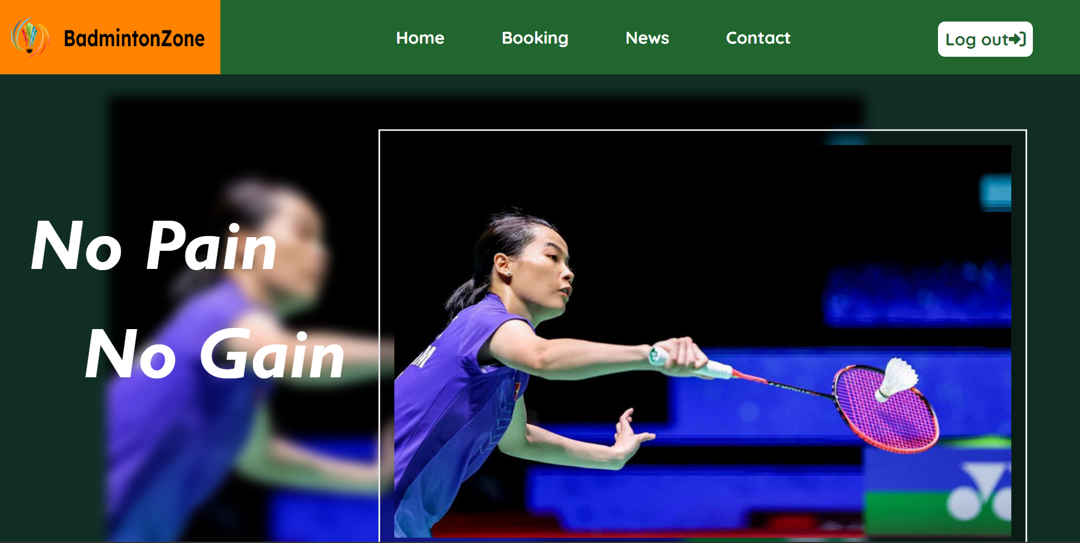
Landing Page

Slide 5
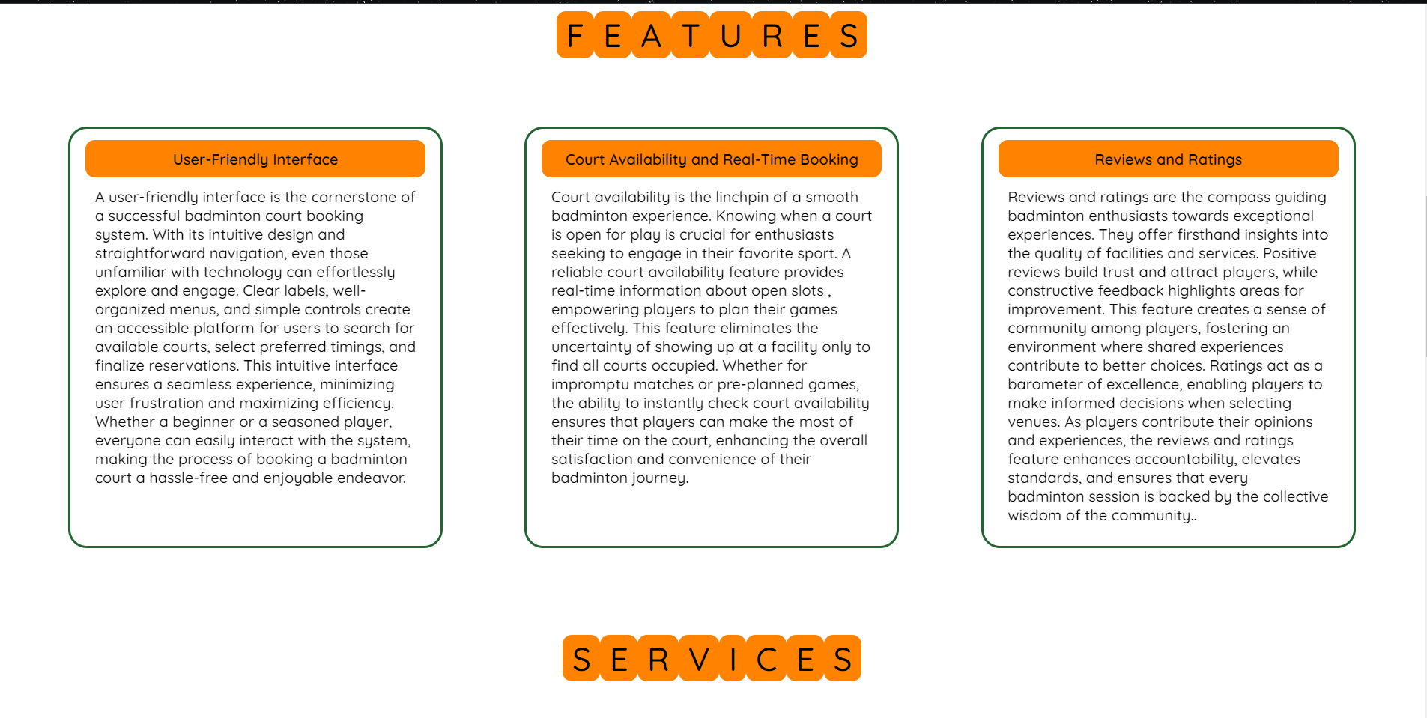
Features of Landing Page

Slide 6

Services of Landing Page

Slide 7
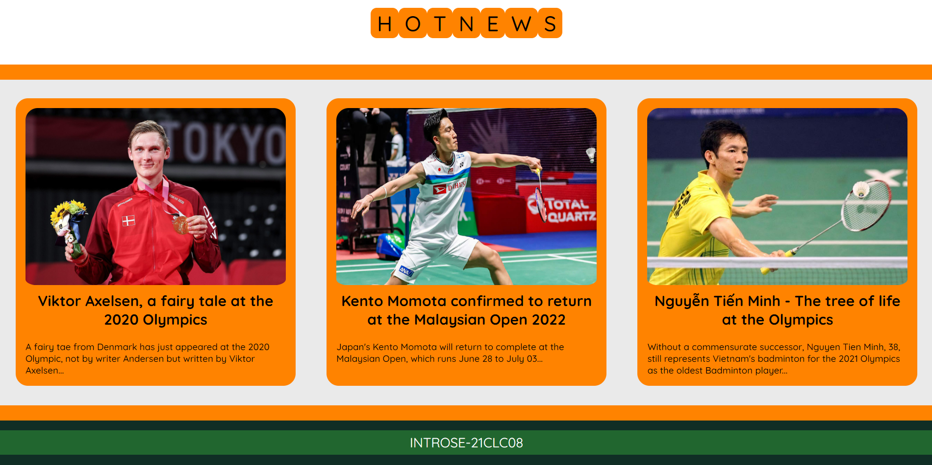
Hot News of Landing Page

Slide 8

Contact Page

Slide 9
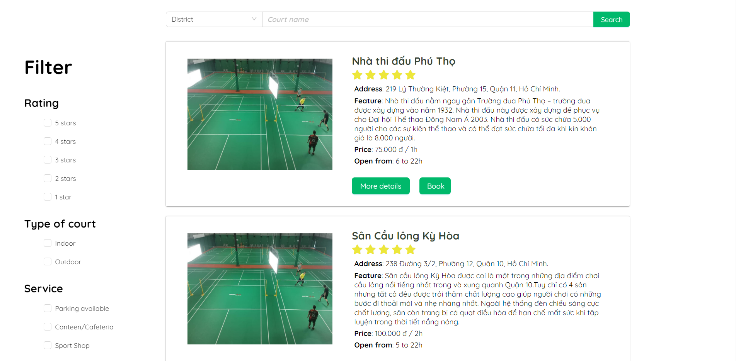
Booking Page

Slide 10

News Page

Slide 11
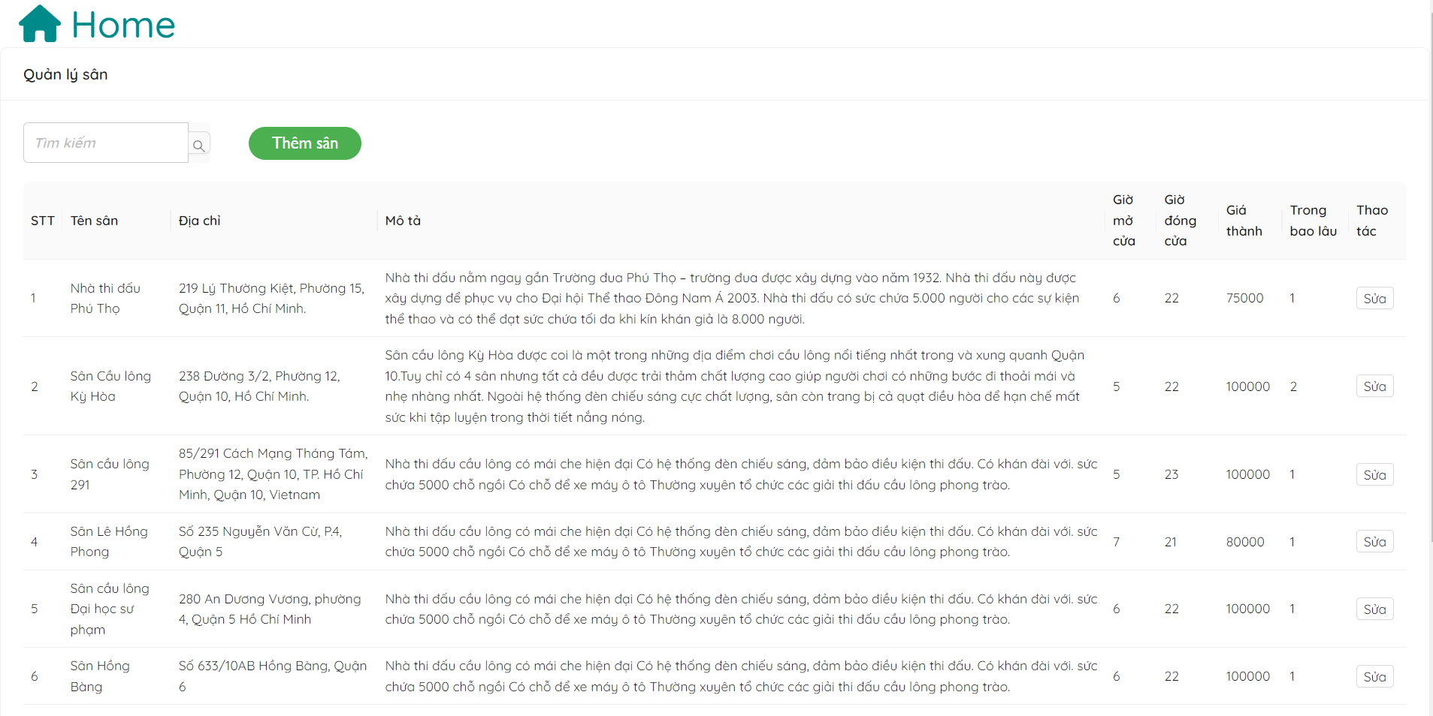
Owner Page to modify courts

Slide 12

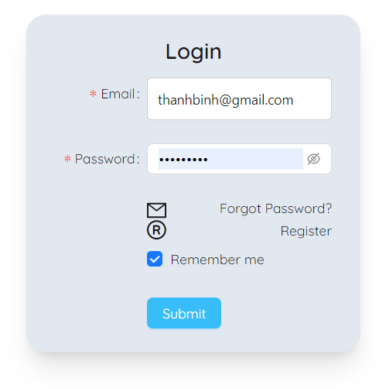
Login Page

Slide 13
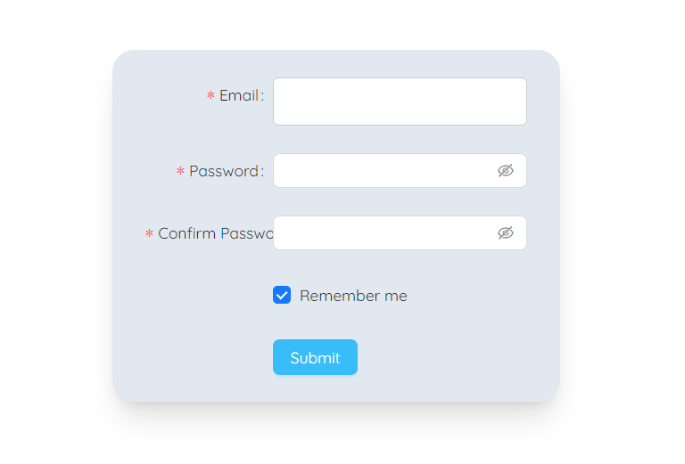
Register Page

Slide 14
The CodeCrafters
Home
Introduction
Content
Reference
THANKS FOR WATCHING!
FRONT-END :
We use several libraries to build this website, such as: ReactJS, AntD, AOS,...
DATABASE :
We use Realtime Database of Firebase.
LINK OF FOLDER OF ALL OUR PAs
https://bit.ly/IntroSE2Group02
LINK OF OUR GITHUB
https://github.com/TNT-B/Badminton-Zone.git
CONTACT US
tntbinh21@clc.fitus.edu.vn

